Slide 1

Inclusive Placement Opportunities for Preschoolers:
A Systems Approach to Inclusion
Learning Environment
A project of the Virginia Department of Education and the
Training and Technical Assistance Centers of Virginia

Slide 2

Module 4:
Learning Environment

Slide 3
Learning Outcomes
Understanding how to arrange to arrange the preschool environment
Understanding how environment impacts learning and behavior
Setting up and assessing your learning environment
Accessing resources
Notes:
Training outcomes for the day. Are there any outcomes you think are more important than others? Are there specific needs for this group or audience?

Slide 4

Shopping
Think about a store where you dislike shopping. Why?
Think about a store where you love to shop. Why?
Notes:
Structure and organization in a store is marketing strategy. It encourages us to be better shoppers and consumers because we know where to look for specific items, where to purchase items, etc.
Activity: At your table, using the big post-it note paper, for stores you dislike to shop in and list as a group, what you dislike; then take the other post-it paper with stores you like to shop in and why! 5 minutes for stores you dislike to shop in and 5 minutes for stores you like to shop in. Share out as a group.

Slide 5
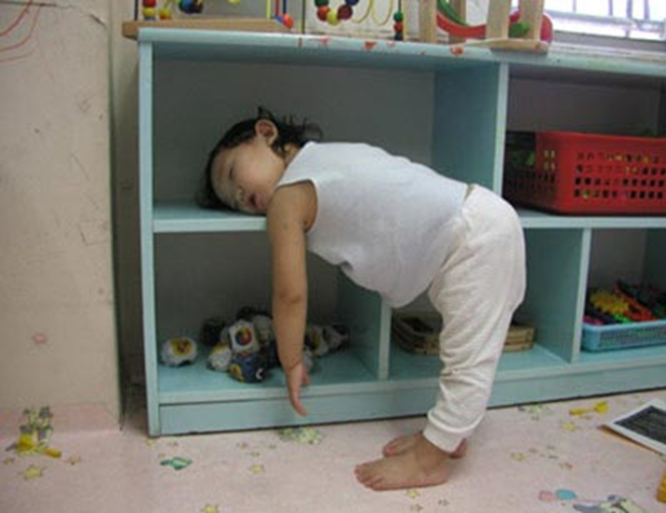
Environments
Provide children with information
What kind of message do you want to send?
Notes:
Just like marketing in stores to get the most from consumers, consider where you do your best work (think, learn, interact, create)?
Consider the space we are in now -
Does it work for you?
Is it comfortable?
Could you be in this space for a long time?
How has the leader prepared the environment for your learning?
Market your classroom! Think about your classroom: What is the structure of your current room?
All learning occurs within a physical environment. Creating smaller spaces that have a particular function within a classroom help children know what to do and where to do it. Also helps build independence, a life long goal.

Slide 6
The Learning Environment
The learning environment includes:
  Space
  Materials
  Equipment
  Routines
  Activities
Notes:
The physical environment includes space, equipment, and materials.
The social environment includes interactions with others such as teachers, children, and caregivers.
The temporal environment includes the length and sequence of routines and activities.
When considering the physical setting, you must consider the actual room design, schedule, activities, number of children & staff, and the types and accessibility of materials.
Often times we have no control over some of these, so it is important to plan ahead and use what you have appropriately.
Some children are overwhelmed by a large space so you may need to adapt the classroom to accommodate them…create smaller spaces, centers areas, etc.
ASK: If the room is too small, how could you create space? If it’s too large, how do you make it more comfortable or cozy?
Clean up the clutter
Use storage boxes
Discard unused items
Organize and put things away
Define centers

Slide 7
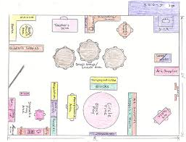
Draw Your Classroom
On a piece of paper, sketch out your classroom as it is now set up.
  Include physical features
  Include designated areas
Notes:
ACTIVITY: Give about five to ten minutes for participants to draw their classroom.
As you go through presentation, ask participants to make notes on their classroom indicating strengths or needs improvement.

Slide 8
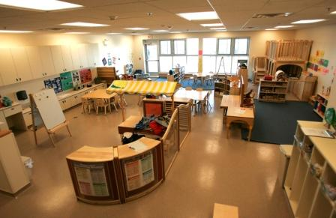
Factors Affecting the Environment
Classroom schedule
Activities
Materials
Staff
Children
Notes:
The physical environment includes space, equipment, and materials.
The social environment includes interactions with others such as teachers, children, and caregivers.
The temporal environment includes the length and sequence of routines and activities.
When considering the physical setting, you must consider the actual room design, schedule, activities, number of children & staff, and the types and accessibility of materials.
Often times we have no control over some of these, so it is important to plan ahead and use what you have appropriately.
Some children are overwhelmed by a large space so you may need to adapt the classroom to accommodate them…create smaller spaces, centers areas, etc.
ASK: If the room is too small, how could you create space? If it’s too large, how do you make it more comfortable or cozy?
Clean up the clutter
Use storage boxes
Discard unused items
Organize and put things away
Define centers

Slide 9
Environmental Considerations
Lighting
Storage
Sound
Adapted equipment
Ventilation – Temperature
Visibility
Color

Slide 10
Why use structure?
Structure in a classroom helps children
  Understand
  Learn easier
  Stay calm
  Achieve independence
  Learn appropriate behaviors
Notes:
Are there any other benefits to using structure in a classroom?

Slide 11
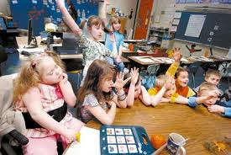
Environmental Considerations (2)
Things to consider :
  Active vs. quiet activities
  Variety of child spaces, including cozy area
  Separate space for adults and children
Notes:
Is anything missing from this list?
Discuss why it is important to have a variety of spaces.

Slide 12
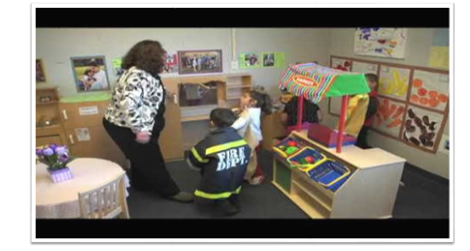
Designing Environments
Retrieved from https://eclkc.ohs.acf.hhs.gov/video/designing-environments
Notes:
https://eclkc.ohs.acf.hhs.gov/video/designing-environments – heading is hyperlinked to video if needed.
4:48 (length of film)

Slide 13
Room Arrangement
Notes:
This provides a design which is also to facilitate engagement and learning.
ASK: Participants should identify the desirable as well as undesirable qualities.

Slide 14
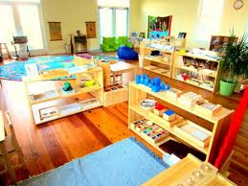
Physical Arrangement
Create specific areas (or zones) in the room
    Limits wandering and running
    Encourages engagement
Scatter centers throughout each zone
Notes:
(Hopefully) a review from discussion of previous slides!
Clearly defining spaces by breaking up the middle of the room and creating specific zones or areas eliminates wide-open spaces.
Much non-engagement happens in wide open, empty spaces between centers.
When center activities are scattered throughout these zones or areas rather than lined up against the walls, children naturally bump into toys and materials. This can encourage participation or engagement as well as independence and social relationships.

Slide 15
Physical Arrangement (2)
Clearly defined relative to activities
Natural traffic paths – no “runways”
Focus on independence, social relationships, engagement
FUN, appealing, and interesting
Notes:
Hopefully, this has all been discussed by participants!
Lockers/cubbies near door.
Quiet areas should be located next to quiet areas and noisy areas near other noisy areas.
Child supplies at child level, adult supplies out of reach.
Activity areas should be located near appropriate classroom fixtures. For example, the art & cooking areas should be near the sink.

Slide 16
Selecting Furniture and Fixtures
Plan for children’s independence.
Engage multiple sensory methods.
Allow for access and active participation in learning activities.
Adapt and modify existing furniture as needed
  Modifications and adaptations should be made for children with mobility needs.
  Bathrooms are a key area for modifications, including adapted seats, potty chairs, private diaper/catheterization changing area.
Notes:
Furniture should be an appropriate height for children. Adults also need appropriate seating.
Commercially made furniture can be expensive, inflexible, and stands out, promoting isolation. It can also be large and heavy to move, limiting the child’s engagement with same-sized peers.
Several adaptations may be required for the bathroom. For example, a child may need an adapted potty chair or an adapted toilet seat that can fit on a regular seat.
Some children may wear diapers or need catheterization and a place should be provided in the bathroom, not the classroom, for changing diapers and catheterization.
These procedures should be explained in simple terms to the other children.
Place pictures of animals, scenery, and shapes next to changing table and on the ceiling to give children something to talk about, encourage language.

Slide 17
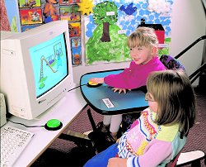
Furniture and Fixtures
Think safety, design, attractiveness
Allow for active participation in activities
Allow for children’s independence
Provide sensory appeal
Notes:
Furniture needs to be same height as peers’.
Commercially made furniture can be expensive, inflexible, and stands out, promoting isolation. It can also be large and heavy to move, limiting the child’s engagement with same-sized peers.

Slide 18
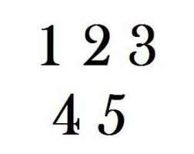
Selecting Classroom Materials
When choosing materials for the classroom, what are five things you should consider?
Turn to a neighbor, discuss, and list.
Notes:
After discussion, share out.
How do participants’ lists compare with following slide? Same, different, additional considerations mentioned?

Slide 19
Selecting Classroom Materials (2)
Classroom materials should:
Be developmentally and culturally appropriate.
Be within children’s zone of proximal development.
Include a variety of toys and materials to encourage parallel, associative, interactive play.
Rotate to relate to classroom themes or learning activities.
Notes:
There should be sufficient quantity of toys (including duplicates of favorite toys), as well as a good variety of toys and materials (toys and materials can stored and rotated frequently).
When children have interesting toys and materials and a responsive environment, they are more likely to be engaged. This is especially important for children with disabilities because children with disabilities have been found to be engaged for less time and at lower levels than their typically developing peers.
The toys and materials should match the children’s preferences and support emerging skill development by being just slightly above skill levels.
Toys should encourage problem solving and mastery motivation and be easily accessible to encourage independence and engagement (but use sabotage, i.e, limit toys or materials to encourage sharing, cooperation and language, when appropriate).
The use of environmental arrangements and the use of child-initiated design enable a teacher to implement incidental teaching strategies.

Slide 20
Materials
Quantity, Quality, & Variety
  Enough for everyone
  Age appropriate for child’s developmental level of play
  At or slightly above skill level
  Accessible, adapted
  Reflect children's interests
Notes:
Again, toys and materials should match the children’s preferences and support emerging skill development by being just slightly above skill levels. Play could be parallel, requiring multiple same toys, associative (playing next to each with similar toys and chatting) and cooperative/interactive (playing together for a common purpose).
Remember that selection of materials, toys and display is intentional teaching. Make sure to provide toys that are interesting to the children, reflecting their interests and cultural background.

Slide 21
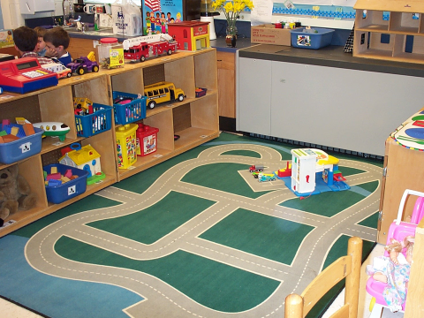
Materials (2)

Slide 22
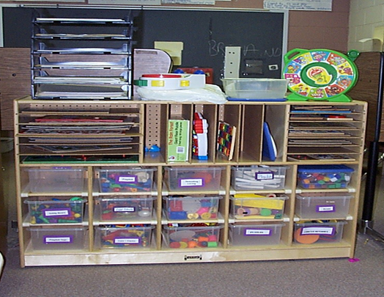
Organization and Storage
  Easily accessible
  Clearly visible
  Clearly label materials
  Tactile cues
Notes:
Some suggestions for adapting classroom materials include:
Low shelves so everyone can reach independently
Clear containers, such as plastic dishpans or shoe boxes, to hold materials and toys with small pieces
Identifying pictures and words printed in block letters allow children to help with cleaning, storing, and organization
Tactile cues assist tactile learners and children with visual impairments
Store materials that go together in the same place
Use pegs, Velcro, or a child-size clothes tree for objects that you want to hang up, such as dress-up clothes, utensils, smocks, etc.
Store shared items such as graters, knives, and electric frying pans for cooking out of reach
When children know where and how things are grouped they can work independently and constructively. They can also participate in meaningful cleanup and care for their classroom. Having a clearly marked place makes it easier for children to return materials at cleanup time.
Labels should have pictures and words in English and the children’s home languages, including a sample of the object itself as part of the label. When materials are labeled this way, cleanup can become a matching and literacy game.

Slide 23
Example: Classroom Materials
Notes:
In this example, classroom materials are developmentally appropriate, easy to access, and represent a variety of skills being targeted. Notice that the bulletin board displays types of buildings recently studied by the class. Children have access to paper, pencils, and drawing materials to create blueprints or make signs. The teacher has purposefully planned for children to engage with the materials in this center in meaningful ways.

Slide 24
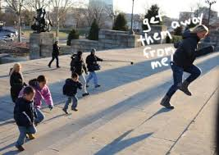
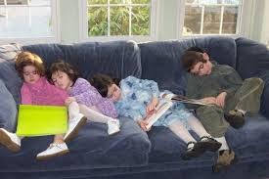
Considerations for Time Blocks
Inclusive opportunities
Children’s state of alertness
Therapeutic service delivery
Transitions
Staffing
Notes:
Don’t get in this situation like this teacher!
While setting up the environment, you also need to consider these things.
WHY?

Slide 25
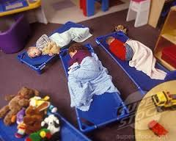
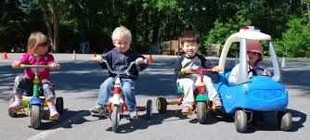
Considerations for Time Blocks (2)
Arrival & Dismissal
Outside Play
Center/Work time (play)
Meals
Rest
Notes:
Arrival & dismissal: Do children arrive/depart all at once or trickle in & out? Is this a time for you to speak with parents? Is breakfast offered? Do all the children get breakfast? If not, then what? Greeting & farewell to children should be pleasurable activities for all involved as it is important for children to feel positive at both the beginning and the end of the day to set a positive tone for the preschool day that is upcoming and for the next day.
Outside: Do they travel long distances on a bus? Who else uses the playground? Do you need to schedule time with other playground users?
Center/Work Time: As we all know, a child’s work is play. This should be a large block of time which can be teacher facilitated and intentional to support children expanding skills, knowledge while creating, interacting, and problem solving.
Meals: Most programs consider eating together family style in the classroom to be one of the most beneficial aspects of lunchtime. These are also great opportunities to develop/enhance language and social skills.
Rest: Provide provisions for students who cannot lie quietly for the specified time period. Focus for non-sleepers should be on quiet, solitary activities. Sleepers and non-sleepers should be separated, either in different rooms or by a partition, if at all possible. Speaking with children in a low voice or whisper will cause them to imitate you, helping to keep noise low.

Slide 26
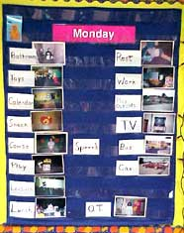
Classroom Schedules
Sequence of daily activities
Time spent in each activity
Pictures/visual cues for each activity
Notes:
A good schedule varies different types of activities — active and quiet times, large group, small group, time to play alone or with others, indoor and outdoor play times, time for children to select their own activities, and time for teacher-directed activities to learn specific skills. Research-based rationale from Creative Curriculum, NAEYC, and DEC:
Teaches sequencing
Organizes the day
Adds predictability/consistency to the day
Teaches routine
Keeps the day flowing
Provides a visual and tangible cue
Gives information on where the child and adults need to be at any given time of the day
Helps children develop concepts of time
Helps children feel more secure and in control of their day
Helps children gain more independence
Cuts down with transition behavioral problems when activities and transitions are carefully and thoughtfully planned.
Consistency does not preclude flexibility and spontaneity, nor does it mean that the clock rules the day.
ACTIVITY: Each team comes up with their top 10 reasons why we need to post a classroom schedule. The first team to complete assignment stands up and receives a prize. Then see if the other teams have anything different to add to the list.

Slide 27
Schedule Considerations
Predictability
Flexibility
Balance
  Active vs. quiet activities
  Structured vs. unstructured
  Independent, One-on-One, large and small group activities
  Acquisition → Generalization activities
Notes:
Predictability - Anchored activities that occur in the same sequence everyday
Flexibility - Changing planned activities or the timing of activities based on children's interests, engagement, and needs (? Or * can be used in the schedule to reflect a surprise activity, visitor, etc.)
Balance - Variety and types of activities prepared and when they occur during the day
CIRCLE: Once or multiple times throughout the day?
Used to welcome everyone and/or to recall the events of the day?
How will time be organized?
Does it have its own routine?
May depend greatly on the developmental levels of the children and the activities.
(Circle can also be used for transitions to bring children together and to reflect where they were and what is next to build in more predictability, if needed).

Slide 28
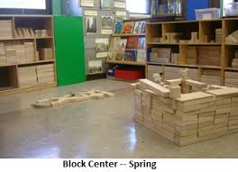
Schedule Considerations (2)
Keep wait times minimal
Plan for transitions and wait times
Provide adequate time for each activity
Notes:
Additional considerations:
Adequate time – Give children a chance to select activities and materials, plan what they want to do, and clean up after. Many times teachers do not allow adequate time for children to take the responsibility to clean up and do it right — not just stuff materials on shelves!
Visibility – Schedules need to be posted at children’s eye level and should include the name of the routine and when it begins and ends. The activities within can be seen from different locations in the room. Individual schedules can be used for any and all children, if appropriate.
Photographs of the children actually performing these activities, other pictures, drawings, and block-print could be used so children can see what happens next in the day.
A visual schedule is particularly helpful for children who have difficulty with transitions. It’s also helpful for subs, volunteers, and other visitors in the classroom.
Schedule more challenging activities in the morning when children are most alert and motivated.
Plan at least 60 minutes a day for each choice time, allowing children to be more deeply involved in their play.
Allow 45-60 minutes for each outdoor period.
Schedule nap time after lunch. Children tend to be sleepy after they eat.
Try to include a play activity in the morning and in the afternoon. Getting up from a nap and going home immediately is hard for most kids.
Block structure: start out with less materials, by spring there are more materials, children know how to play with the blocks and leave the structure so children can add on to the structure!

Slide 29
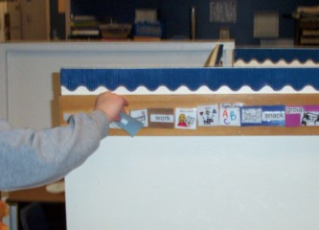
Schedule Considerations (3)
Labeled visual schedule
Make it child/user friendly
Teach it
Encourage child’s use
Notes:
Points to remember:
Put the daily schedule IN FRONT of your students
Display it at your students’ EYE LEVEL
Point to it and describe your classroom day
Allow students to take off parts of the day and put into the “finished” spot throughout the day…draw attention to the schedule all day
Recording the schedule:
To keep you on target
To help you remember what you planned to do
To help staff members keep track of their own roles
To help children structure their day/week
Some ways to post:
Picture wall schedule
Flip charts (small or large)
Velcro notebook
Strip schedule
*** Individual schedules for children who need one

Slide 30
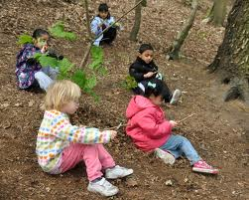
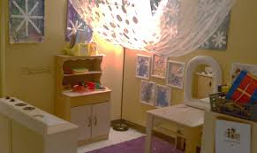
Planning for Transitions
Research indicates children lose significant instructional time with unplanned transitions.
How can you plan to embed instructional time in transitions?
Notes:
Research indicates that many children spend too much of their school day involved in transitions between activities and locations. A huge loss of instructional time!
Transitions that are not carefully planned are time-consuming and chaotic and set the stage for disruptive behaviors. Well-planned transitions provide the opportunity for children to practice independence and are an opportunity to build or enhance a child’s self-confidence and self-esteem at managing themselves and materials as they transition from one activity or location to another.
Plan, plan, plan!
Prepare, prepare, prepare!
Occur throughout the day.
Should be fun.

Slide 31
Unplanned Transitions
High probability for disruptive behavior occurs before, during, and after a transition if children are:
  unsure of what to do
  given inadequate time to switch between activities
  not provided warning

Slide 32

Transitions
Therefore,
Plan
Fun and short – reinforce content & skills
Plan for children who need extra assistance
Notes:
Use routine transitions, familiarity
Use to reinforce content and skills
For children who use a wheelchair or gait trainer or need adult supervision, try to include activities that would encourage as much independence as possible or try to pair child with a more competent child to assist with the transition.

Slide 33
Smooth Transitions
Provide:
  Visual cues
  Self-directed activities for early finishers
  Wait time
  Specific instructions and practice
To reduce challenging behavior before, during, and after transition:
  Provide clear expectations.
  Plan for adequate time to transition from one activity to another.
  Provide a transition warning as a cue to prepare for transition.
Notes:
ASK participants what a smooth transition looks like before showing bullet points slide.
ACTIVITY: In small groups, each group lists five ways to create smooth transitions. Brainstorm how you can you embed specific instructional activities in these transitions.
Remember to think about some of your go-to transition warnings? Why did these work well for your classroom?
Are there any transition warnings that have not worked well in your classroom? If so, why do you think they did not result in a smooth transition?

Slide 34
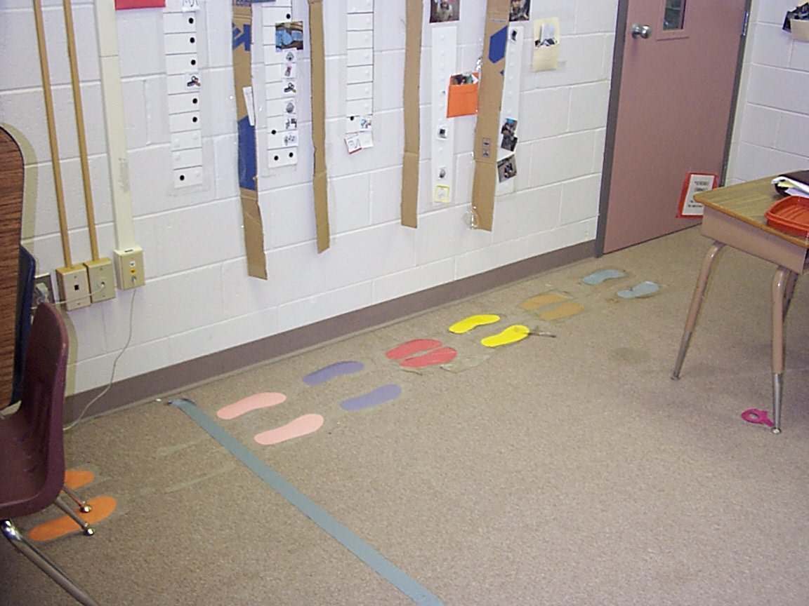
Supporting Smooth Transitions

Slide 35
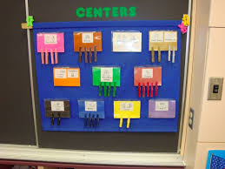
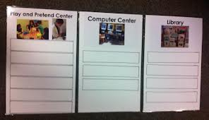
Arranging Centers
Identify center by name
Identify number permitted in each area
Adequate materials for children and activities
Notes:
Use change of flooring, dividers, bookshelves, hanging canopy, change in color, change in lighting, colored tape, etc. to indicate specific areas.

Slide 36
Arrival and Greeting
Warm, loving, and enthusiastic greeting
Peer/adult assistance to help with the transition
Plan for late arrivers
Extra support for children with additional needs
Notes:
Remember to use peers first for helpers and models rather than adults. Adults can be free to facilitate the process and not necessarily be directly involved.
Have a process or protocol for the late arrivals so as not to disrupt the class routine.
Ease the child into the routine with little disruption – sometimes this is a teachable moment - identify friends, recalling names, etc.
Make sure the other adults and substitutes know the process as well.

Slide 37
Circle
When planning circle time consider:
Purpose
Duration
Opportunities to encourage and enhance language and social emotional skills
Developmentally appropriate for all children
Availability of technology for all
Notes:
Depending on the age and characteristics of the kids, circle time should last for five to 15 minutes.
n the beginning of the year, start short and slowly work up to a longer period as children become familiar with the routine and mature.
Begin the day by discussing the day’s plans, changes in the schedules, review of the week or weekend, etc. It can Set the tone for the day
Starting the morning a similar way each day, such as by singing a good morning song, provides a sameness that gives students predictability and consistency.
Encouraging and enhancing skills should occur throughout the day whenever opportunities arise. Encourage reasoning skills, model and extend language using peers, and provide time to learn and practice skills!
If you have a talented staff, rotate the role of circle facilitator. This will give you an excellent opportunity to see the children from another perspective. Circle time may not require the support of as many adult staff; they may be involved in the preparation of other activities.
No-tech and low-tech to mid-tech devices should be accessible for everyone to use, from the shy or inquisitive child to a child with a disability.

Slide 38
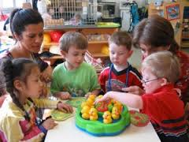
Centers and Free Choice
Duration
Purpose
Accessibility
Availability of technology
Child initiated vs. teacher directed
Notes:
Keep working with small groups in the beginning of the year, gradually increasing in numbers as children get to know each other, the class routine, and behavioral expectations.
Provide at least 45-60 minutes of purposeful play. This allows children time to develop play, skills, and language. When activity is a short 20 minutes there really is no time for children to have any depth to their play, skills, and abilities.
If there is a product that children produce during their play, is there a way to preserve the product and keep it safe? For example, setting aside a structure so that children can continue to build and expand it during future play sessions.
Some children may require additional support and adaptations for participation. You have to consider how much adult support is needed to support the child’s goals.

Slide 39
Meal Time
During mealtimes:
Embed opportunities to practice language and adaptive skills/objectives.
Promote independence.
  Provide adapted utensils, seating, and positioning when necessary.
  Be aware of nutrition and oral sensory motor needs.
Notes:
This is a wonderful opportunity to embed IEP objectives, introduce nutritional or oral sensory motor issues, and content into the activity without the children being the wiser. Bringing out food and the opportunity to cook or make something allows the rich language experience to explode. Children are born with a healthy dose of curiosity and wonderment. Given the right ingredients and tools they will begin to experiment and talk about their experiences.
Snack and lunch times serve as a great opportunity for conversations about family, traditions, and culture. Make it sociable with pleasant conversation or a story before lunch.
Keep in mind that if you keep jumping up from the table to get things, children will do the same thing. Keep extra food items on a cart nearby. Easy access to extra napkins, sponges, cups, and a pair of scissors to open things is also helpful.
Encourage children to help by providing small pitchers, baskets, and sturdy serving utensils that children can use to pour their own milk or juice and serve their own food. Give children time to practice with pitchers during water play and be tolerant of spills and accidents. Keep paper towels and sponges handy.
Mealtimes should not be rushed. Some children are slow eaters and should be allowed enough time. Make there is also enough time for setting up, eating, and cleaning up.
Never use food to punish or reward behavior. This develops unhealthy attitudes towards food. Instead, deal with the inappropriate behavior.

Slide 40
Outdoor Play
When planning outdoor play:
Consider gross motor development.
Provide accessible and adapted activities.
Consider the level of support needed.
Have alternate plans for changes in weather or schedules.
Consider level of support: child-to-child interaction vs. adult interaction
Notes:
Plan for a large motor activity during morning and afternoon times. Kids need to move.
Remember safety issues as well. Place soft material under swings and climbing apparatus.
Have enough riding, pedal-type toys, and adaptations (e.g., built up pedals and straps).

Slide 41
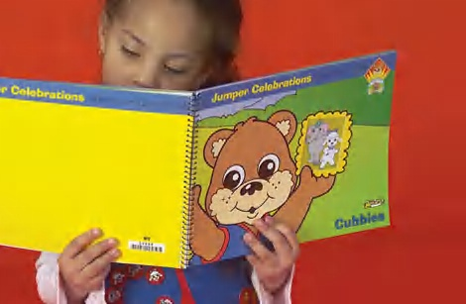
Story Time
Consider attention spans
Diverse books; representative of class, school, community
Child involvement vs. sitting and listening
Notes:
Individual reading opportunities in addition to teacher led story books and activities.

Slide 42
Closing
Method for dismissal
Plan for various schedules, such as individual pick-up and different buses
Notes:
If you don’t have a well thought-out plan for dismissal, you can easily have a classroom thrown into complete chaos...children in various stages of alertness and probably irritability, coupled with a fragmented bus dismissal where some children leave earlier. A few children are being picked up by caregivers and everyone wants a few minutes of teacher time, not to mention a child who’s crying uncontrollably. Does this sound familiar?
Work with your assistants and volunteers to plan a process by which the children are to get ready to leave. Specify who is responsible for specific tasks, such as greeting and meeting caregivers, and talking with bus and van drivers.
Write out the plan just in case you might be out or your assistant needs instructions. It beats having to remember everything. Have the person read it over and ask questions if necessary.

Slide 43
Promoting Appropriate Behavior
Strategies for holding attention.
Visuals to support independence.
Plan each transition as part of the lesson plan.
Notes:
As we discussed earlier in this presentation, how you set up your physical space is a prevention strategy.
The flow of activities, the appropriateness of materials when matching your interests and student needs, organization of materials, and staff collaboration all impact the classroom atmosphere. If children are not engaged in meaningful, purposeful activities they will find something else to do, which may end up as behavior and communication breakdowns. Careful planning of activities and the environment with your children in mind can prevent most behavior and communication breakdowns.
As discussed earlier, the activities, physical space, and instructional strategies need to facilitate, support, and stimulate child’s learning.

Slide 44
Promoting Appropriate Behavior (2)
What behaviors are challenging in your learning environment?
What are physical aspects that contribute to these behaviors?
How might you change the space?
Notes:
ACTIVITY: Ask tables or small groups to use the worksheet “How the Physical Space Can Affect Behavior” as a guide for identifying challenging behaviors and coming up with a plan to reduce them by modifying the physical space. Give 5-10 minutes for groups to complete the worksheet and ask tables write 2-3 words or phrases describing their behaviors on a post-it note. Participants will place these post-it notes on a board or sheet near the front of the room. While facilitating a large-group share-out use these post-it notes to guide discussion. Ask participants to share a response to this behavior and why they believe this response will reduce these challenging behaviors.

Slide 45
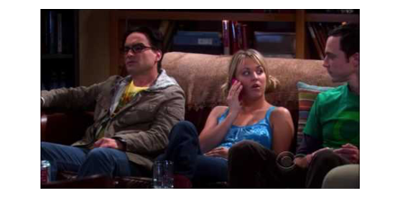
Promoting Appropriate Behavior (Slide 3)
Retrieved from https://www.youtube.com/
watch?v=LEJqowyuyi0&feature=youtu.be
Notes:
Video: In this example, Sheldon uses chocolate to reinforce Penny’s desired behavior. The chocolate is motivating for Penny.
Ask: Are the reinforcers in the classroom matching the motivation of the students? Why or why not? How can the learning environment act as a reinforcer?
(1:54 is the length of the film)
https://www.youtube.com/watch?v=LEJqowyuyi0&feature=youtu.be

Slide 46

Collaborating with Professionals
Communication and collaboration
Continued professional development
Team meetings
Staff support
Notes:
Knowing each others’ roles and responsibilities is important, as are collaboration, communication, and making the time to plan as a team.
Using a structured meeting process will help facilitate effective and efficient team meetings. Subsequent team meetings may go smoother as items are discussed openly and candidly as roles and responsibilities may shift during the year.
There are numerous tasks that need to be completed prior to the start of any preschool day. Coordinating the completion of the tasks and identifying responsibilities at the start of the school year goes a long way in collaborating and communicating with the team.
Remember, it is the IEP team’s responsibility to design a child’s individualized education program. The special education teacher, general education teacher, paraprofessional(s), and therapists are responsible for implementation.
Is there administrative support for team meetings? For professional development? For inclusion?
Administrative support for team meetings, professional development, and inclusion must be available from the building administrator, principal, central office, SPED director, Title 1 supervisor, Head Start disabilities coordinator, and others for successful implementation.
You must also evaluate who among the staff may need additional training or information on disability.
Be aware of the staff’s expertise, experience, and background as they can be identified as a strength or a liability (e.g., nurturing personality or strict disciplinarian).
How will related service personnel, such as the OT, SLP, or PT, provide services — within the classroom or pull out for individual instruction?
Within the classroom, it is important to evaluate if the degree or level of support promotes independence.
The staff should also be questioned to determine if adults are doing things the child can do for himself or herself.

Slide 47
Identifying Teacher Roles
Zone Defense Schedule:
Organizes adult roles.
Clear responsibilities for each adult.
  One adult is in the set-up role.
  Other adult(s) focus on learning activities and children.
Notes:
In basketball, the term “zone defense” is when players are responsible for an area of the court rather than a specific player on the other team.
Zone Defense Scheduling (ZDS) in early childhood educational settings is one method for organizing the staff in classrooms. Staff are assigned specific roles or tasks during times of the day and the children move between the teachers rather than teachers following specific children around the classroom.
The primary goal of the ZDS is to decrease the rate of child non-engagement by having at least one adult directly observing and interacting with the children at all times.
Organizing adults using the ZDS can make transitions between activities easier for children, increase opportunities for instruction, and potentially decrease behavior challenges.

Slide 48
Two-Person ZDS Example
Time | Person 1 | Person 2
8:00-8:15 | Arrival | Set Up
8:15-8:30 | Set Up | Story
8:30-8:45 | Free Play | Set Up
8:45-9:00 | Set Up | Circle
9:00-9:15 | Small Toys | Set up
9:15-9:30 | Set Up | Centers
9:30-9:45 | Set Up | Centers
9:45-10:00 | Snack | Set Up
10:00-10:45 | Set Up | Bathroom and Outside/Hallway
10:45-11:00 | Music | Set Up
11:00-11:15 | Set Up | Art
Notes:
This schedule illustrates how a ZDS works with two staff in a classroom (but it’s a lousy schedule!).
Indicate to the participants how the staff move back and forth between the two roles.

Slide 49
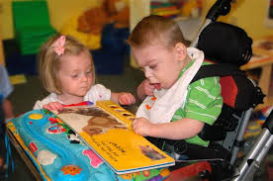
Planning for Learning
Number of children
Characteristics of the children
Needs of all children
Same-aged peers
Notes:
The ratio of children to adults is important. It’s better to have a greater number of children as they learn better from each other and it’s better to have language and behavior models for children with delays.
The classroom environment in an inclusive program must be designed to meet the needs of all children.
Gifted children, English language learners, and those with developmental delays all have unique needs that will need to be considered. All these children need to be actively engaged in activities and tasks of interest to them since children learn best from each other.
The gifted child can become a model, friend, or tutor for children needing extra assistance.
English language learners who have developed a solid foundation in their first language are more efficient in learning a second language and the skills and concepts learned in the child’s first language will transfer to the second language. Being immersed in another language is a win-win situation. You and the class will be learning words and cultural tidbits about another language and country while the child is learning English.
Depending on the age of the children, it is important to have a good understanding of typical development (young two year olds to three- and four year olds). Having realistic expectations for your children is paramount in any preschool classroom. You will gain an awareness of typical behavioral, social, emotional, and motor expectations of the children in your charge.

Slide 50
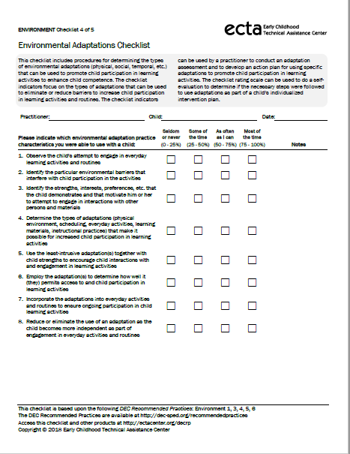
Environmental Adaptations Checklist
Notes:
Using your environmental adaptations checklist as a resource, begin to look at your classroom design to make enhancements.

Slide 51
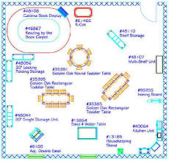
Putting It All Together
What would you change, if anything, about your classroom environment?
Notes:
ACTIVITY: Ask participants to re-visit their classroom drawings and checklists. Provide 5-10 minutes for participants to indicate any changes they plan to make to their classroom environment or suggestions for materials, routines, etc. Participants can do this in a Think-Pair-Share format with a partner at their table. Provide the opportunity for a whole group share-out at the end.

Slide 52
Resources
Cryer, D., Harms, T., & Riley, C. (2003). All about the ECERS-R. Lewisville, NC: Kaplan.
Grisham-Brown, J., Hemmeter, M.L., & Pretti-Frontczak, K. (2017). Blended practices for teaching young children in inclusive settings (2nd ed.). Baltimore: Paul H. Brookes.
Harms, T., Clifford, R.M., & Cryer, D. (2015). Early childhood environment rating scale (3rd ed.). New York: Teachers College Press
Johnson, J., Rahn, N.L., & Bricker, D. (2015). An activity-based approach to early intervention (4th ed.). Baltimore: Paul H. Brookes.

Slide 53
Resources (2)
Souto-Manning, Rabadi-Raol, Robinson, Perez. (June, 2019). What Stories Do My Classroom and Its Materials Tell? Preparing Early Childhood Teachers to Engage in Equitable and Inclusive Teaching. DEC Young Exceptional Children, 22 (2), 62-73.
Pretti-Frontczak, K., & Bricker, D. (2004). An activity-based approach to early intervention (3rd ed.). Baltimore: Paul H. Brookes.
Sandall, S.R., & Schwartz, I.S. (2008). Building blocks for teaching preschoolers with special needs (2nd ed.). Baltimore: Paul H. Brookes.

Slide 54
Web Resources, Slide 1
Center on the Social and Emotional Foundations for Early Learning (CSEFEL), Vanderbilt University http://csefel.vanderbilt.edu/resources/social_emotional_competence.html
The National Center for Pyramid Model Innovations, University of South Florida http://challengingbehavior.cbcs.usf.edu/index.html
Early Childhood Technical Assistance Center
http://ectacenter.org/~pdfs/decrp/ENV-4_Environmental_Adaptations_2018.pdf
Notes:
Promoting Social Emotional Competence training manuals are available at each regional T/TAC, along with training partners from a nearby locality. A list is available from your regional T/TAC.

Slide 55
Web Resources, Slide 2
The Iris Center http://iris.peabody.vanderbilt.edu
  www.do2learn.com
    FREE line drawings, task strips, etc. for visuals
  www.4teachers.org
    Design a classroom, integrate technology into your classroom by offering online tools and resources. This site helps teachers locate and create ready-to-use Web lessons, quizzes, rubrics, and classroom calendars. There are also tools for student use
  www.enablingdevices.com
    Great resource for adapted toys & materials

Slide 56
Web Resources, Slide 3
  www.lekotek.org
    The National Lekotek Center focuses on learning through play for children with disabilities. The Web site provides resources about selecting toys for children with disabilities. They rate commercially available toys. http://www.lekotek.org/ableplay/ableplay-and-great-finds
  www.beyondplay.com
    Focuses on young children with special needs (early intervention), for parents and professionals

Slide 57
Web Resources, Slide 4
TTAC Online: www.ttaconline.org
VDOE TTAC ECSE Contacts
https://va-leads-ecse.org/ecse-ttac-contacts

Slide 58
Thank You!
If you have any questions about the content in this module or need further assistance implementing a systems approach to early childhood inclusive practices, please contact the early childhood staff at the following T/TACs.
Regions 1 & 8 VCU 804-828-6947 or 434-292-3723
Regions 2 & 3 ODU 757-683-4333
Region 4 GMU 703-993-4496
Region 5 JMU 540-568-6746
Regions 6 & 7 VT 540-231-5167

